Slide 1
Lessons from Yahoo’s Homepage:
5 Tips for High Availability
Jake Loomis
Yahoo! VP of Service Engineering

Slide 2
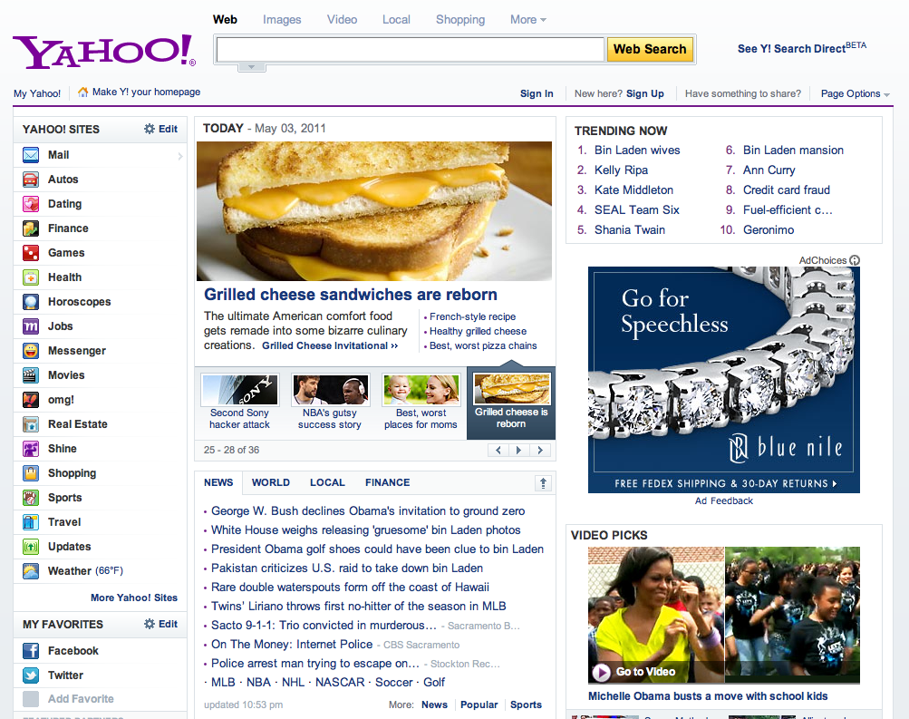
What is Yahoo! Homepage?
Largest internet portal
Launching point to the entire Yahoo! network
Over 627,000,000 users
Over 40,000 requests per second

Slide 3
Outage Headlines
Yahoo DOWN: Yahoo.com Outage Reported (HuffingtonPost)
Amazon Apologizes for Outage, Offers Credit (Wall Street Journal)
PlayStation Network Fiasco: Sony CEO Stringer's Head Must Roll (Business Insider)

Slide 4

Tip #1:
Redundancy for everything
http://www.mamapop.com/2010/11/top-1-scariest-movie-moment-ever-according-to-bhj-movie-expert.html/shining-twins
Notes:
Redundancy story: squirrel in a colo, DNS, planned change
DNS (??), Network (??)
Servers
disposable
reboot/offline at anytime with minimal user impact (filo test)
Software
configurable features (rapidly disable a feature)
easy to deploy, document and refine
Colo
practice BCP scenarios regularly, document and refine
audit capacity, plan for traffic spikes and BCP traffic
Dependencies
work with providers to understand their limitations and communicate yours
don’t wait for them to fail, design features with the expectation they will fail

Slide 5
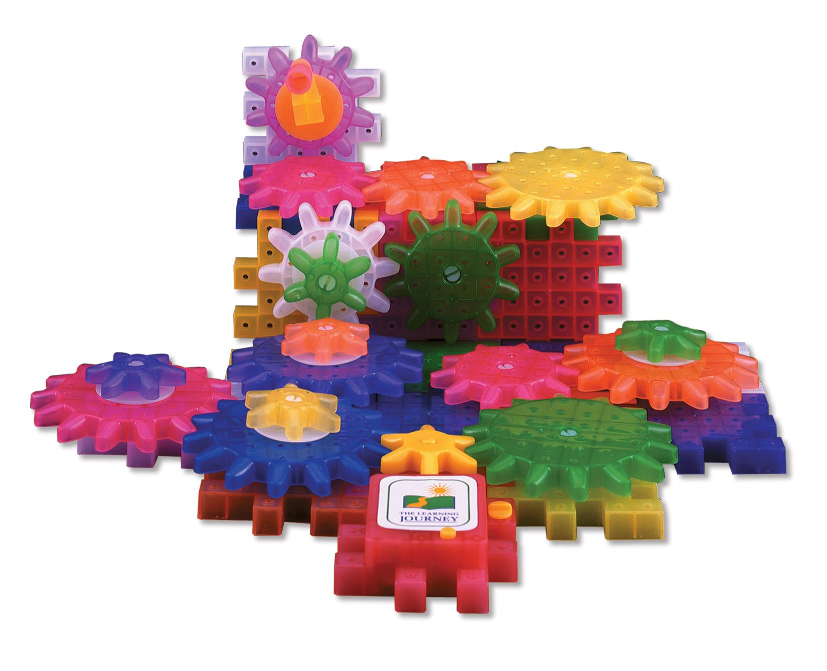
Tip #1 Redundancy:
Understand your system’s failure points
http://www.superdairyboy.com/pictures/learning_journey/techno_gears.jpg
Notes:
http://www.superdairyboy.com/pictures/learning_journey/techno_gears.jpg
Hint: all of them

Slide 6
Tip #1
Full Redundancy
We break all the time, it’s rare that user’s are actually impacted.
Server down
  Load balanced, stateless servers can pick up load
Network device down
  Automatically reroute to redundant network path
Colo loses power
  Failover to colo in another region
Per-model Today/News/Top Trending Searches module ranking
  Fallback to editorial stories
User database unavailable
  Show signed out experience
Ad lookup fails
  Fallback to static, build-based ad
Page fails completely!
  show a static page generated from cron

Slide 7
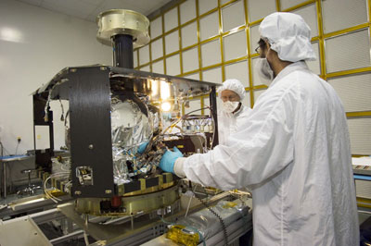
Tip #2 Error proofing change:
Make changes in a safe environment
Notes:
Starts with the software release process…
Continuous Integration environment with automated build, unit test, deploy, and test for each check-in.
smoke test each build before promoting to the next environment
shame hat for build breakers¹
QA environment with automated tests and debug statements where logs and monitors are closely watched throughout the release cycle.
Forked copies of production traffic in Staging catches new error messages before going to production, and QA/Engineering/Operations are involved in the entire process.
Production deployment includes dark launched code which is reviewed and validated, then activated in a phased rollout.

Slide 8
Tip #2:
Practice how you play
Starts with the software release process…
  Continuous Integration environment with automated build, unit test, deploy, and test for each check-in.
    Smoke test each build before promoting to the next environment
    Automated email blame to offending committer(s)
  Automated tests and debug statements in QA environment
    Logs and monitors are closely watched throughout the release cycle.
  Forked copies of production traffic to staging environment
    Catches new error messages before going to production
    QA/Engineering/Operations are involved in the entire process.
  Dark launched code
    Pushed first, then activated incrementally

Slide 9
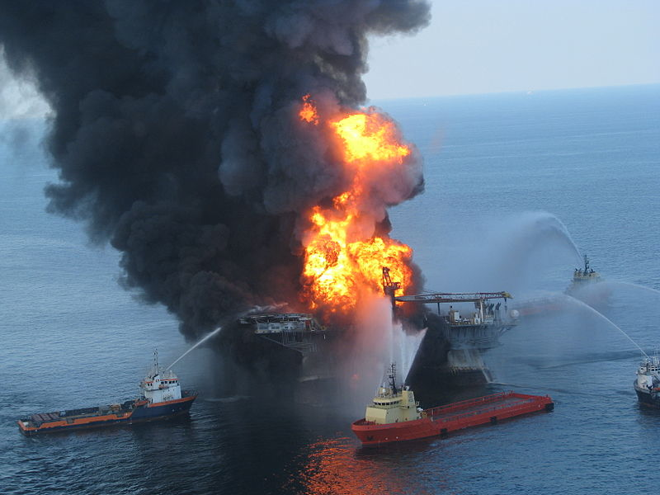
Tip #2 Error proofing change:
Recover quickly
http://www.bettermsreport.com/wp-content/uploads/2010/05/oil-rig-fire.jpg

Slide 10

Tip #3:
Global Load Balancing
http://madraider.com/Greekgods/Atlas.html
Notes:
Global load balancing
Route traffic to nearest of over a dozen colos worldwide
Ability to serve any market from any data center
Use in failure scenarios, maintenance, code changes, testing, etc.
Able to sustain a complete outage in any international country or region whether network, power or act of god.
If a dependency is impacted in one colo, fail out and allow the rest to handle it.
BCP should be as simple as possible to execute. It’s hard enough to think at 2am.
Minimize fear of BCP by doing it regularly

Slide 11
Tip #3:
Global Load Balancing
Global load balancing
  Route traffic to nearest of over a dozen colos worldwide
  Ability to serve any market from any data center
  Use in failure scenarios, maintenance, code changes, testing, etc.
  Able to sustain a complete outage in any international country or region whether network, power or act of god.
  If a dependency is impacted in one colo, fail out and allow the rest to handle it.
    BCP should be as simple as possible to execute. It’s hard enough to think at 2am.
    Minimize fear of BCP by doing it regularly

Slide 12
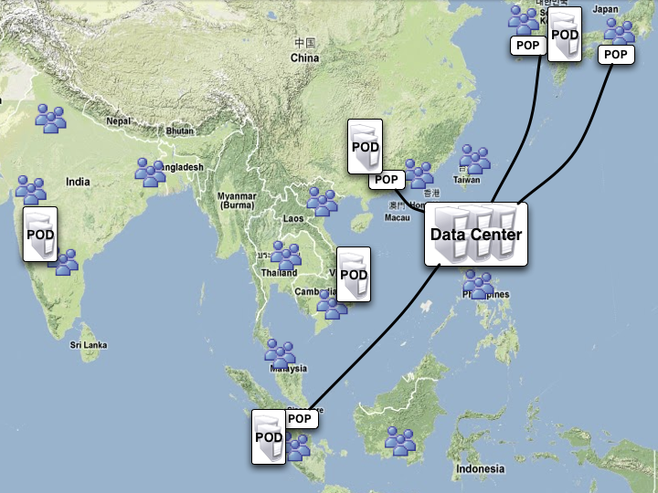
Edge Pods: Small Compute Footprints
Used to Optimize Cost and Performance
Cost optimization by offloading heavy bandwidth (streaming)
Performance optimization by reducing latency to end-users (cache & proxy)
Yahoo! Presentation Template, Confidential
12

Slide 13
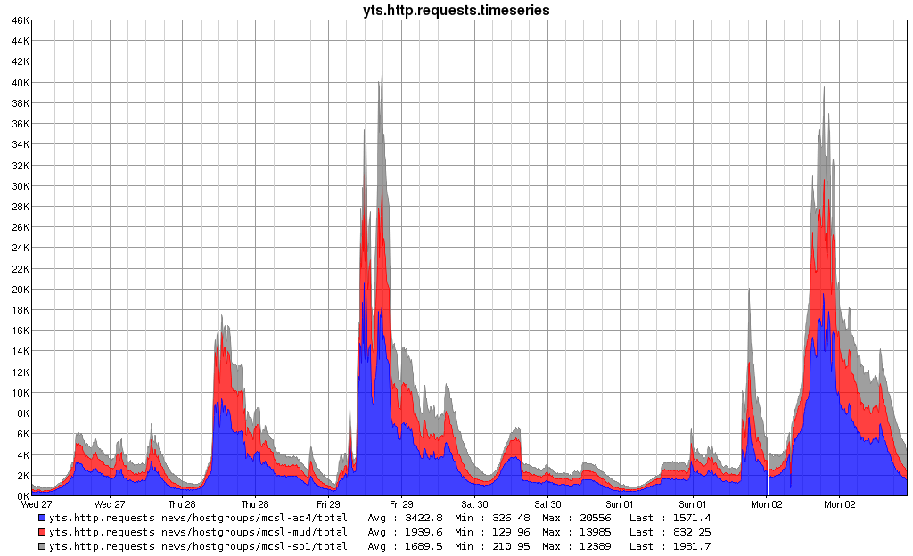
Tip 4:
Monitor Everything
Royal Wedding
Peak 1:
Balcony Kiss,
East Coast wakes up
RW Peak 2:
41k (West Coast
wakes up)
Bin Laden Peak:
40k (West Coast
wakes up)
Thurs:
Tornado
Sun:
Bin Laden’s
death
Wed:
6K (Normal Day)
Notes:
All dependencies within strict SLA
Ads, user data, any backend service
Minimize impact of uncontrollable factors (network, power, etc)
Senior engineers with data cards debugging 24/7 within 5 mins of any alert
System level monitoring (per host)
End-to-end functionality (per host)
Content “freshness” (per host)
Client side performance (overall)
Server side duration (per hostgroup, per colo)
Traffic levels, week over week (per hostgroup, per colo)
Metrics, metrics, metrics (as much as your budget can handle)
graphs are nice
alerts are better

Slide 14

Tip #5:
Fallback plans in case of failure
http://www.lucidmagazine.com/Daredevil-On-A-Tightrope
Notes:
Where’s the net? Royal Wedding story: rerouting traffic,
We break all the time, it’s rare that user’s are actually impacted.
Per-model Today/News/Top Trending Searches module ranking
fallback to GA ranking
fallback to dummy stories
User database unavailable
show signed out experience
Ad lookup fails
fallback to CMS-managed ad
fallback to static, build-based ad
Page fails completely!
show a static page generated from cron

Slide 15

Tip #5 Fallback Plans:
Isolate failure
http://nolamotion.files.wordpress.com/2009/07/dunce-cap.jpg
Notes:
Turn off dependencies that are behaving badly

Slide 16
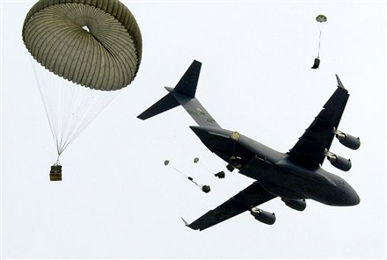
Tip #5 Fallback Plans:
Drop features to add capacity
Notes:
http://www.chron.com/commons/persona.html?newspaperUserId=luftmann&plckController=PersonaBlog&plckScript=personaScript&plckElementId=personaDest&plckPersonaPage=BlogViewTag&plckBlogId=luftmann&plckTag=airdrop
Meltdown plan

Slide 17
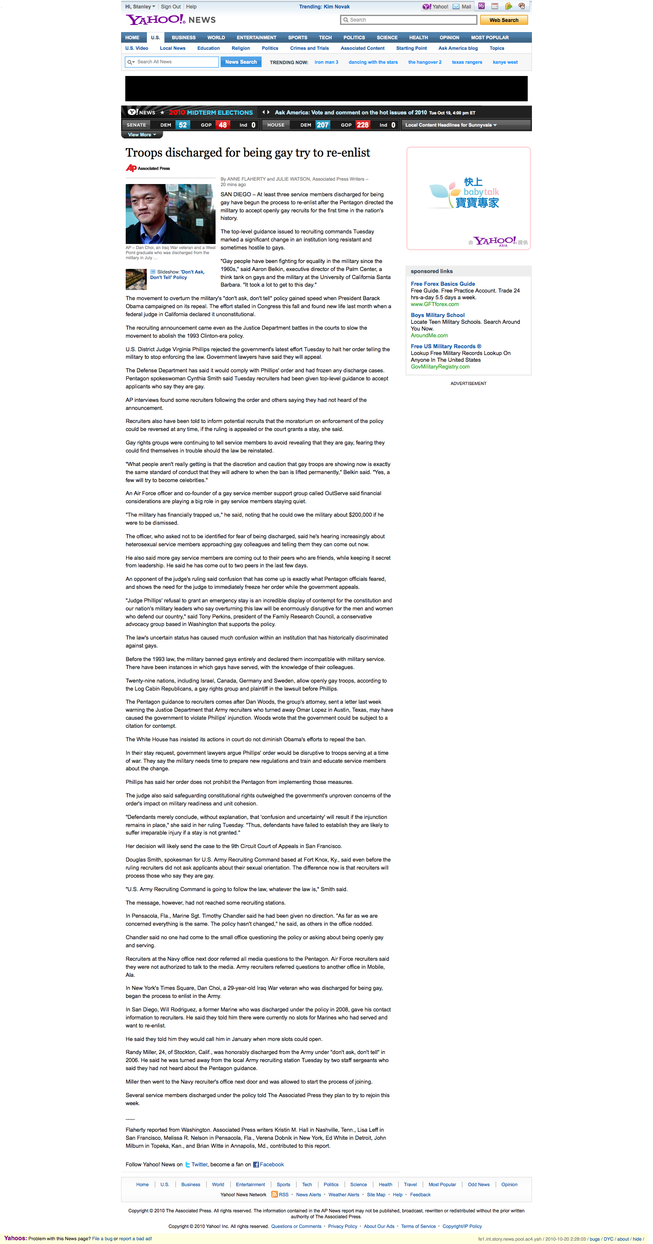
Streamline Serving
Tier 0
  Change top stories to BE api instead of coke api
Tier 1
  Comments
Tier 2
  promote top/mid bar (left rail)
Tier 3
  Yahoo! finance/ Yahoo! Sports (only in specific sections)
  Education
  Infinite browse
Tier 4
  Featured module / Editor picks
  Top stories
Tier 5
  Related contents
  Site features

Slide 18
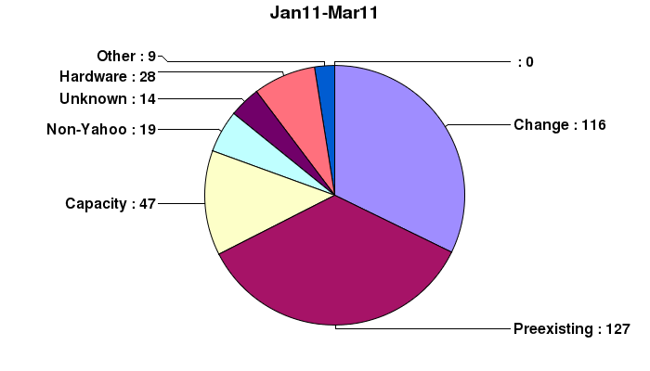
Tip #5 Fallback Plans:
Learn from your mistakes, followup on your learnings

Slide 19

Bonus Tip:
Talent
http://images2.alphacoders.com/756/75652.jpg
Notes:
http://images2.alphacoders.com/756/75652.jpg
Hires stars; hire to the position; Postmortems – learn from mistakes

Slide 20
Service Engineering Responsibilities
Service Support
24/7 Multi-tiered Pager Support
Runbooks
Monitoring
Alerting
SLAs
Incident Management
Postmortems
Remediations
Problem Management
Service Delivery
Configuration Mgmt
Capacity Planning
New Hardware Deployment Process
BCP/SPOF
Release/Deployment Process
Operational Arch review
Security Issues
Maintainability/ Standardization
Notes:
And lastly techniques will not cover everything…
Kick-ass Ops
Passionate about what they do
IM’s from the co-founders are fantastic motivators
Developers are friends, not enemies
Invest early, get operations involved even during the product definition phase
Dig through the code, review the logs, make recommendations
Include the developers in the deployment process, most are curious to see what happens
Share your monitoring, input and criticism should be welecome
Buying a beer or giving a hug goes a long way

Slide 21
Top 5 Tips revisited
Design for failure
Error proof change
Redundancy for everything
Global load balancing
Monitor everything
Fallback plans

Slide 22
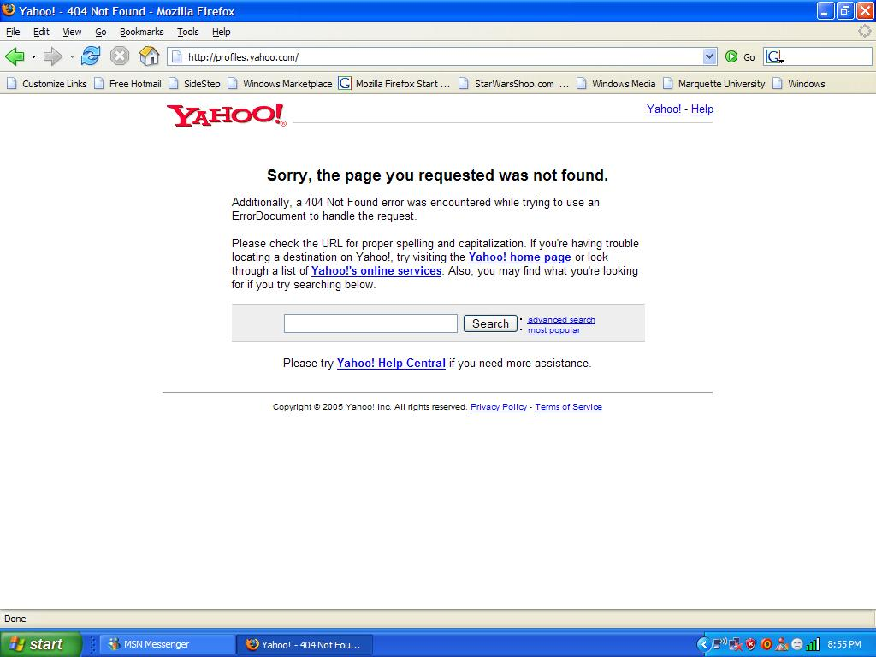
Explanation of Homepage outage
Notes:
Bug that caused machines to rebuild cache when they exceeded memory in cache
Pushed change safely but did not mirror production environment exactly
Activated change all at once
Simultaneous failure brought down multiple colos
Unable to logon to boxes to rollback
Relied too heavily on talent not to trigger known bug
Frontpage dark deploys code to the FE web servers
Most configuration values are stored in APC cache for fast access.
more markets, more dimensions = more APC cache needed
As the new code gets enabled per-market, APC usage doubles (cache for the previous release and cache for the new release)
APC will graciously purge cache entries if the cache fills up (Cache full count), which in our case are required for serving requests.
if cache is purged, can take up to 6 seconds for one request to re-populate the config dimensions
if a host is in rotation, this brings the server to a halt
Cache full count was triggered in 3 out of 5 of our US colos
automatic failout of affected colos
all US-based traffic was set to the remaining 2 colos
Frontpage was provisioned to handle a 2 colo failure in the US causing the remaining colos to fallover

Slide 23
Q&A

